Slide 1

EGN 5442 Term Project Group 1
12/1/25
Andre Archer, Mary Meyer, Ashley Foster

Slide 2


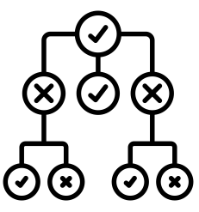

Introduction – College Basketball Dataset
Input Data
Feature Extraction
Classification/Regression
Prediction
Modeling of college basketball statistics enables an understanding of what stats actually matter

Slide 3





Chosen Dataset
College basketball dataset for 2013 – 2025 Division I teams
Includes data for:
Adjusted offensive efficiency (ADJOE)
Adjusted defense efficiency (ADJDE)
Power rating (BARTHAG)
Effective field goal % shot and allowed
Turnover rate
+more
Team (361 teams)
Conference (34 conferences)
Number of games
Number of wins

Slide 4



Motivation
Team Performance
ML Modeling of Complex/Continuous Game
Win %/Tournament Qualification
Goals:
1) Predict a team’s win percentage based on their performance statistic
2) Predict if a team made the NCAA tournament based on performance

Slide 5


Pre-Processing Steps
2013 – 2024
dataset
Partial 2025 dataset
Full dataset from 2013 – part of 2025
Remove any empty cells/NaN values and replace with 0 and split data into testing/training
Convert string/object columns to integers using one hot encoding
Combine datasets together
Somewhere between – clean up data using domain knowledge to not double count stats/features

Slide 6
Pre-Processing
Needed to combine 2025 data into 2013-2024 dataset
Not all single season data is present for larger set (Rank, 3PR, 3P%...)
Restricted some variables in modeling (common issue with sports data)
Features kept:
Efficiency on offense/defense, turnover rates, rebound rates, free throw stats, conference, adjusted tempo
Features dropped:
Year, team name, wins above average, BARTHAG (power rating), 2-point rates on offense/defense

Slide 7
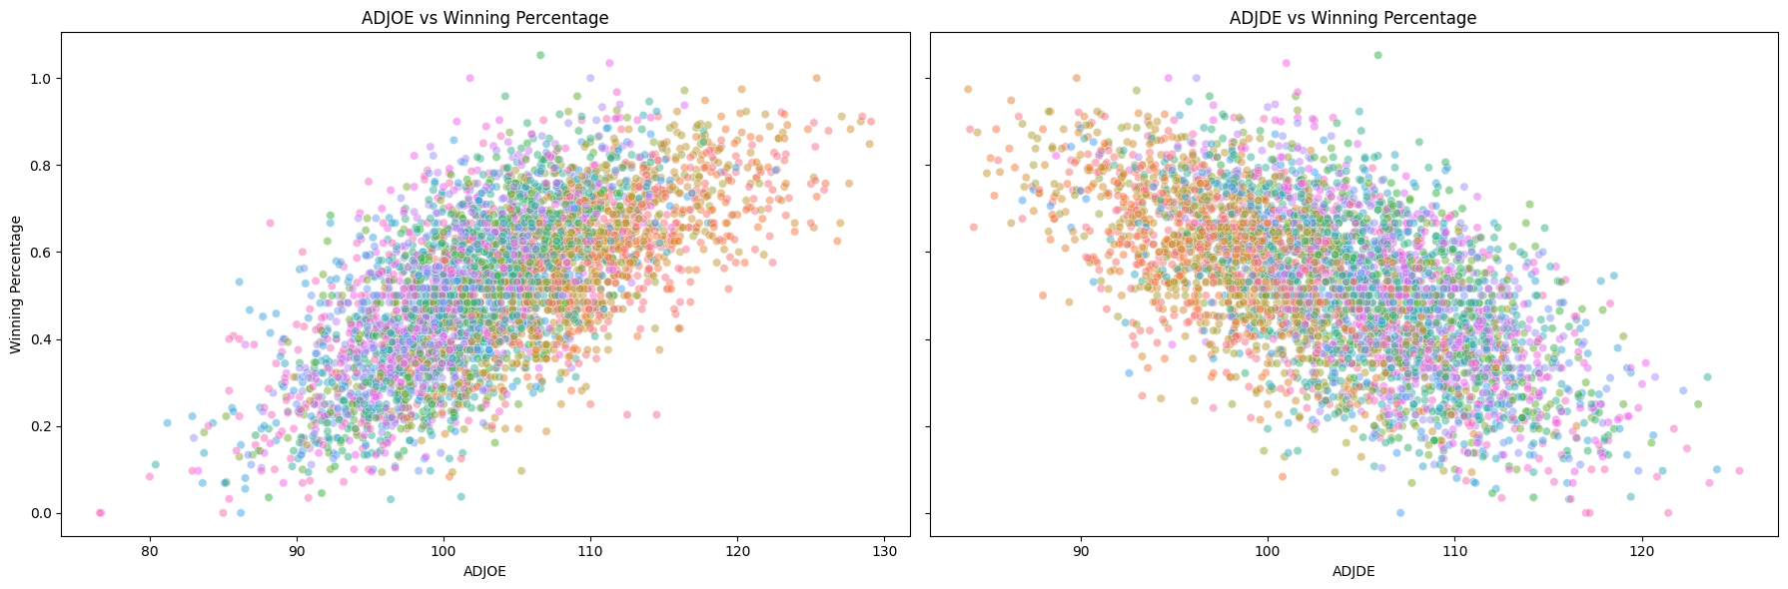
Basic Trends of Scoring
Are these the only two things that matter for win % and making the tournament?

Slide 8
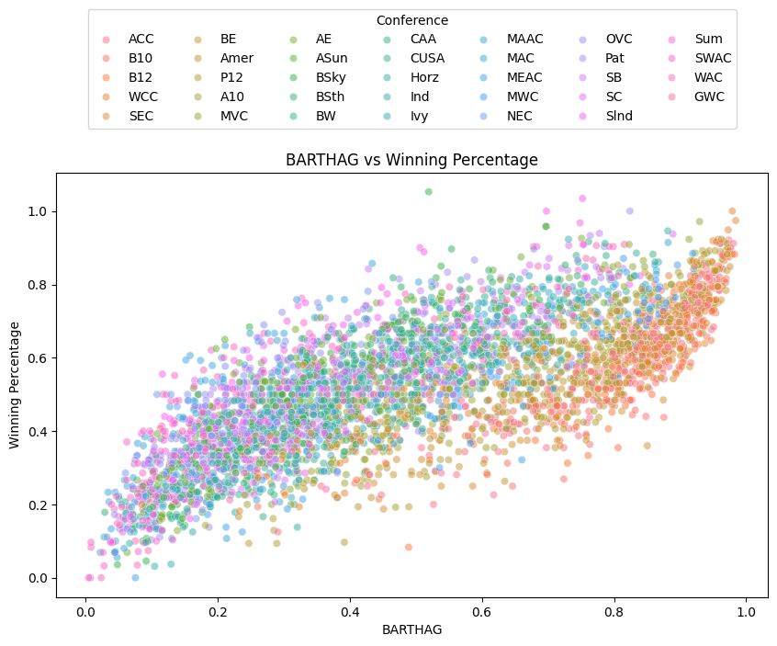
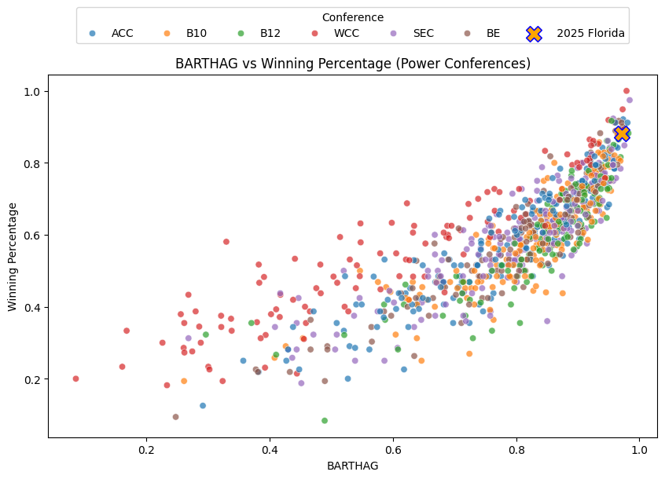
Concept of Power Conference + Importance

Slide 9
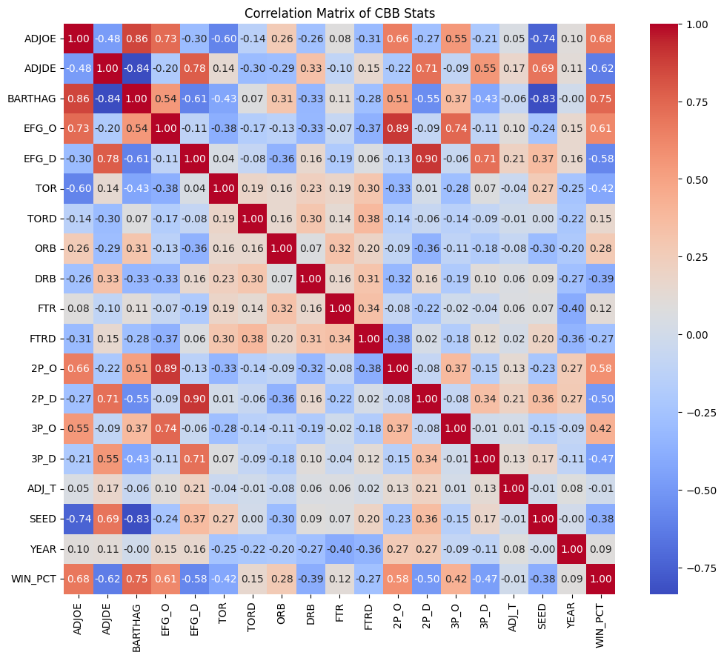
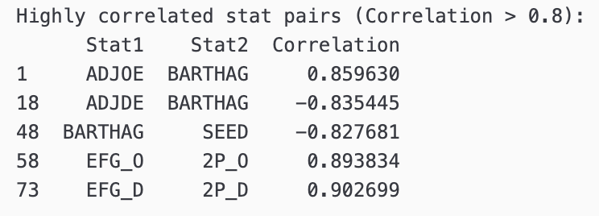
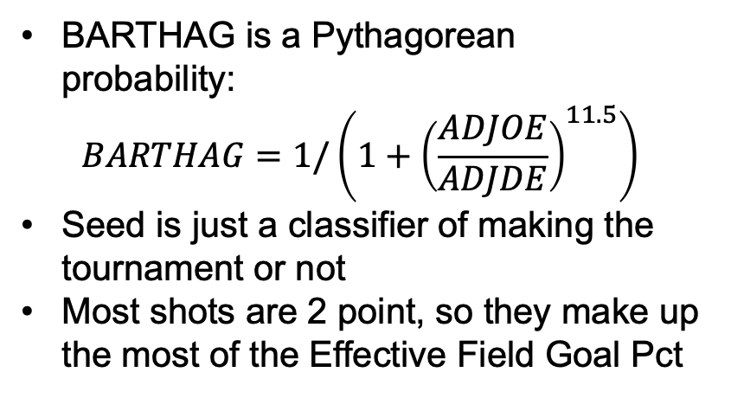
Correlation Matrix:
BARTHAG is a Pythagorean probability:
$$BARTHAG=1/\left(1+{\left(\frac{ADJOE}{ADJDE}\right)}^{11.5}\right)$$
Seed is just a classifier of making the tournament or not
Most shots are 2 point, so they make up the most of the Effective Field Goal Pct

Slide 10
Win %
Tournament Qualification
Initial:
Linear Regression (LR)
Requires scaling of values for feature interpretation
Advanced:
Gradient Boosting Regression (GBR)
No scaling needed
Two methods of handling conf:
Binary assignment of values (Power conference or not)
One-hot encoding for each individual conference
Random Forest Classification:
Fast and easy to implement
No hyperparameter tuning used here
Not sensitive to imbalanced dataset
Decided to implement after noticing impact conference can have on win %
Do better conferences get free passes?

Slide 11
Hyperparameter Optimization
RandomizedSearchCV used for both LR and GBR
Optimized model hyperparameters:
LR – Binary Classification
LR – One-Hot Encoded Classification
GBR – Binary Classification
GBR – One-Hot Encoded Classification

Slide 12
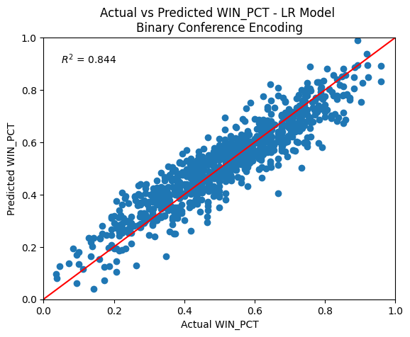
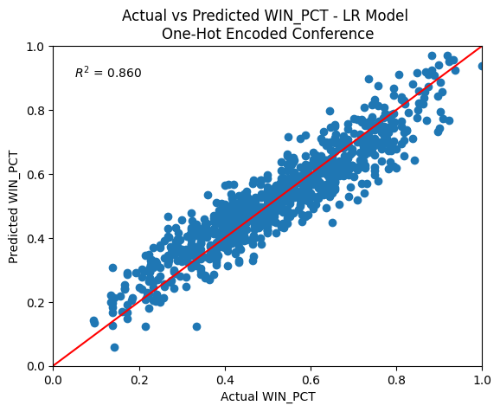
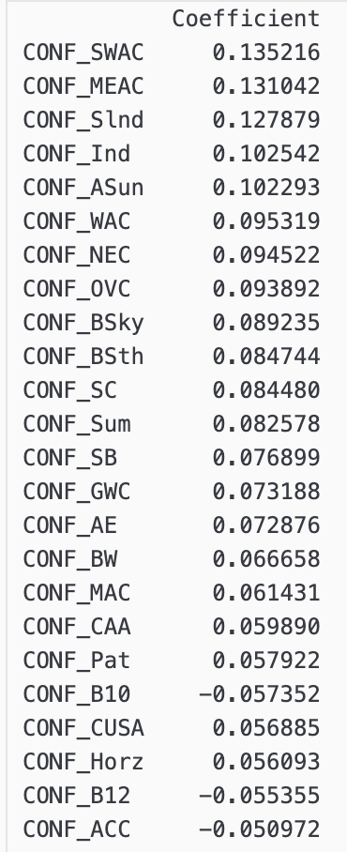
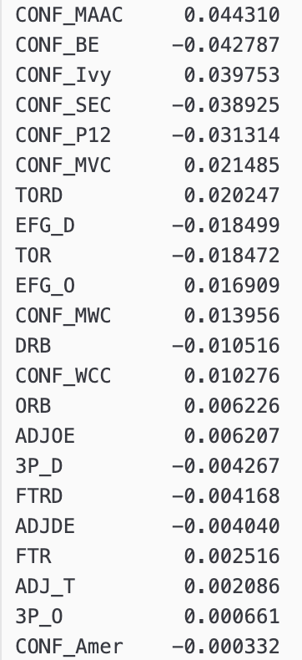
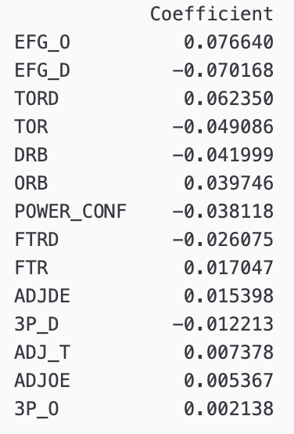
Linear Regression Results
Hyperparameter tuning did not significantly improve the R² value

Slide 13
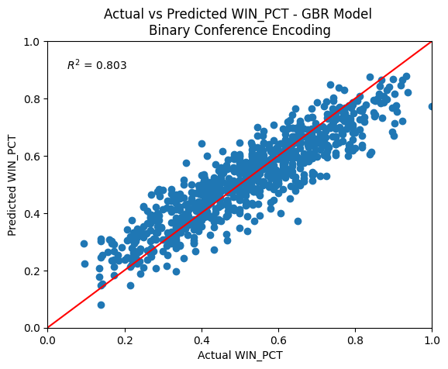
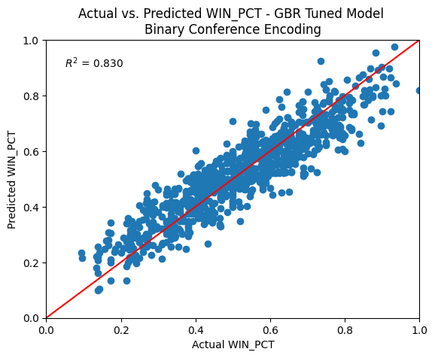
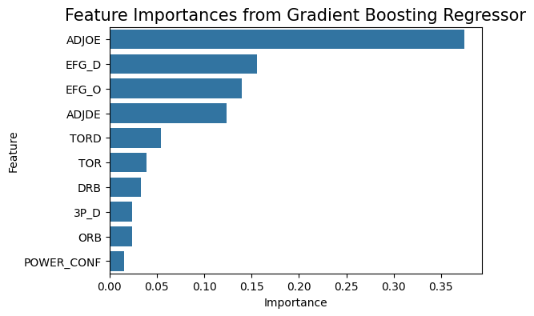

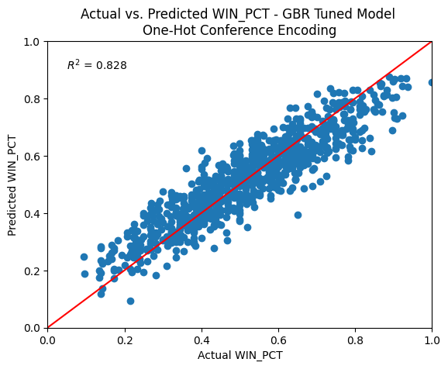
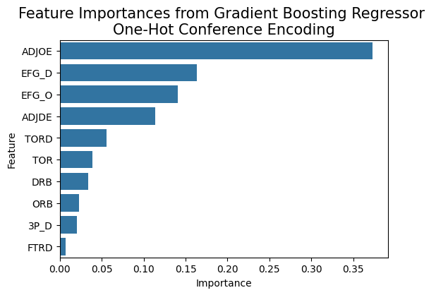
Gradient Boosted Regression Results
Before Tuning
After Tuning
Binary Classification
One-Hot Encoding

Slide 14
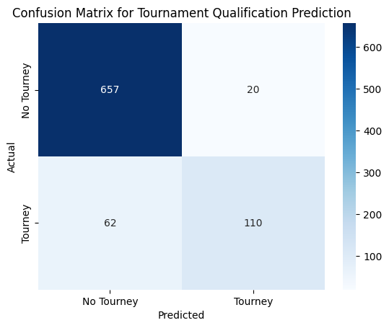
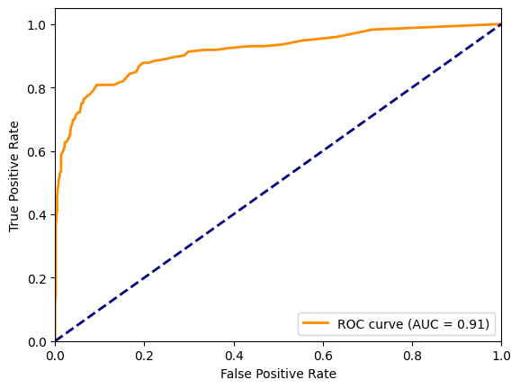
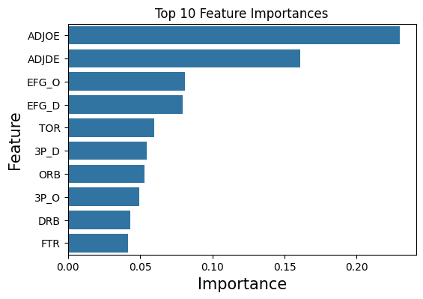
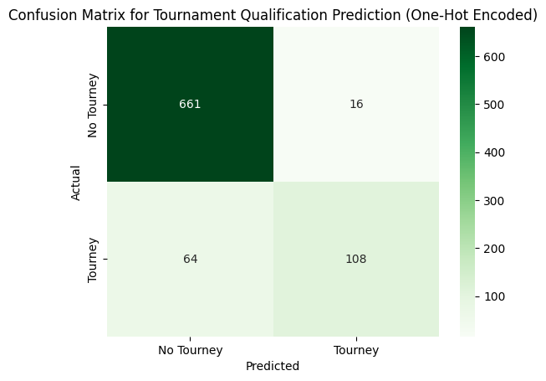
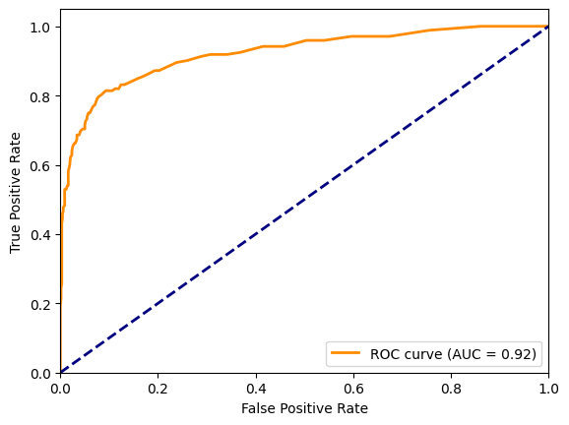
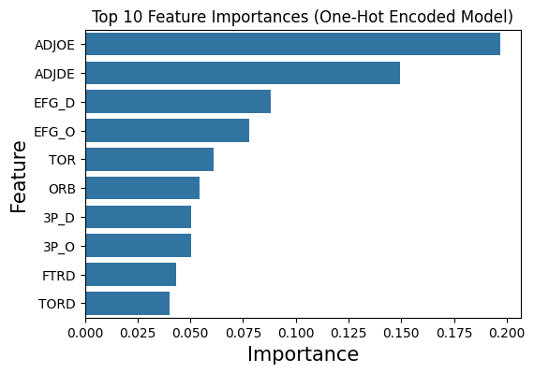
Random Forest Classification - Tournament
Binary Classification
One-Hot Encoding

Slide 15
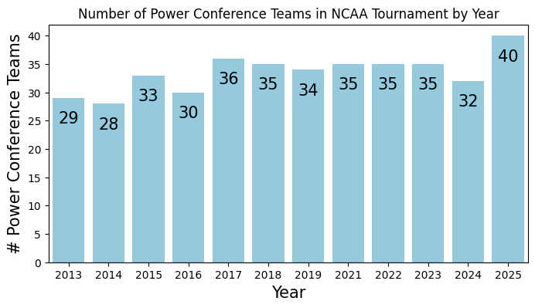
Discussion + Takeaways
In general, more efficient offense is most important factor and more efficient defense is 2nd most important factor
Score more points and don’t let other team score = more wins!
How much does conference matter?
6 conferences make up >50% of tournament
Models show this is based on better performance
To increase win %, create weaker schedule!
To make the tournament, play better!

Slide 16
Conclusions
College basketball dataset for 2013 – 2025 Division I teams
Used linear regression and GBR to predict and understand win %
Used random forest classifier to predict tournament qualification
Limitations:
Dataset is limited to about 4000 rows
Does not include roster data, total points, coaching data, NIL money
Game by game data is likely more predictive + expansive

